Slide 1
Binomial Heaps
Dr. Ashish Sharma

Slide 2
Binomial Trees
Binomial Heaps
Representing Binomial Heaps
Why Binomial Heaps?
Binomial Heap Operations
-Make-Binomial-Heap
-Binomial-Heap-Minimum
-Binomial-Heap-Union
-Binomial-Heap-Insert
-Binomial-Heap-Decrease-Key
Applications

Slide 3

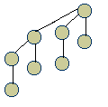
Binomial Trees
A Binomial tree can be defined recursively where:
A binomial tree B_{k} consists of two B_{k-1} binomial trees that are linked together. The root of one is the leftmost child of the root of the other.
Properties of a binomial tree are given by the following lemma:
  1. there are 2^{k} nodes
  2. the height of the tree is k
  3. there are exactly ^{K}C₃ nodes at depth I for I = 0, 1, …, k and
  4. the root has degree k, which is greater than that of any other node
B_{k}
B₀
B₀
B₁
B₂
B₃
B_{k-1}
B_{k-1}

Slide 4
Binomial Heaps
A binomial heap, H, is a set of binomial trees that satisfies the following binomial-heap properties.
Each binomial tree in H is heap-ordered: the key of a node is greater than or equal to the key of its parent
- the root of a heap-ordered tree contains the smallest key in a given sub-tree
There is at most one binomial sub-tree in H whose root has a given degree
- there are at most log(n) + 1 binomial sub-trees.
Proof: Binary representation of n,< b_{(logn)}, b_{(logn–1)}, …, b₀ > can be given by: _{i = logn}
n = Σ (b_{i}2^{i})
^{I = 0}
By property of 1 of Lemma, b_{i} appears in H if and only if bit b_{i} is 1.

Slide 5
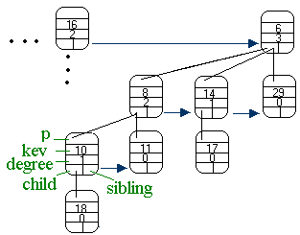
Representing Binomial Heaps
x: key
head[x]: pointer to the root (if NIL, binomial heap is empty)
p[x]: pointer to the parent(if x is the root, then NIL)
child[x]: leftmost child (if node has no children,then NIL)
sibling[x]: sibling of x immediately to its right (rightmost child of parent, then NIL)

Slide 6
Why Binomial Heaps?
Binomial Heap presents data structures known as mergeable heaps. The worst case for the UNIION operation is considerably much better than other data structures.
Procedure | Binary Heap Worst Case | Binomial Heap (worst-case) | Fibonacci heap (amortized)
Make Heap | Θ(1) | Θ(1) | Θ(1)
Insert | Θ(lgn) | O(lg n) | Θ(1)
Minimum | Θ(1) | O(lg N) | Θ(1)
Extract-Min | Θ(lg n) | Θ(lg n) | O(lg n)
Union | Θ(n) | O(lg n) | Θ(1)
Decrease-Key | Θ(lg n) | Θ(lg n) | Θ(1)
Delete | Θ(lg n) | Θ(lg n) | Θ(lg n)

Slide 7
Make-Binomial-Heap
Make-Binomial-Heap()
Allocates and returns an object H, where head[H] = NIL
Running time: O(1)

Slide 8
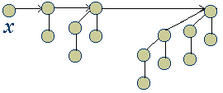
Binomial-Heap-Minimum
-returns a pointer to the node with the minimum key in an n-node binomial heap
Binomial-Heap-Minimum(H)
y ← NIL
x ← head[H}
min ← ∞
while x ≠ NIL
do if key[x] < min
then min ← key[x]
y ← x
x ← sibling[z]
//go to the right till no more siblings
return y
Running time: O(logn)

Slide 9
Binomial-Heap-Union:
Merging Heaps
Binomial-Heap-Union(H₁, H₂)
H ← Make-Binomial-Heap()
head[H] ← Binomial-Heap-Merge(H₁, H₂)
free the objects H₁ and H₂ but not the lists they point to
if head[H] = NIL
then return H
prev-x ← NIL
x ← head[H]
next-x ← sibling[x]
while next-x ≠ NIL
do if (degree[x] ≠ degree[next-x]) or
(sibling[next-x] ≠ NIL
and degree[sibling[next-x]] = degree[x])
then prev-x ← x
x ← next-x
else if key[x] <= key[next-x]
then sibling[x] ← sibling[next-x]
Binomial-Link(next-x, x)
else if prev-x = NIL
then head[H] ← next-x
else sibling[prev-x] ← next-x
Binomial-Link(x, next-x)
x ← next-x
next-x ← sibling[x]
return H
Stage 1
Stage 2
Stage 3
Case 1 & 2
Case 3
Stage 4
Case 4

Slide 10
Binomial-Heap-Union
Stage 1: Start merging root lists of binomial heaps H₁ and H₂ into a single root list H. The root list is strictly in increasing degree
Stage 2: Check for empty heap
Stage 3: Initialize prev-x, x and next-x
Stage 4: decide which sub-trees to link to each other depending types of cases:
Case 1: degree[x] ≠ degree[next-x]
Case 2: degree[x] = degree[next-x] =degree[sibling[next-x]]
Case 3 & 4: degree[x] = degree[next-x] ≠ degree[sibling[next-x]]
AIM: to merge two trees until there is no more than 1 sub- tree of a certain degree.

Slide 11


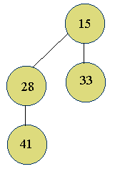


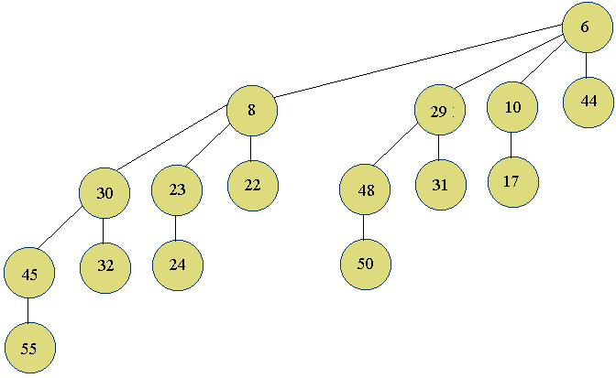


Binomial-Heap-Union
H₁
H₂
Case 3: degree[x] = degree[next-x]
x
next-x
H

Slide 12


Binomial-Heap-Union
prev-x
x
next-x
H
Case 4: degree[x] = degree[next-x] ≠ degree[sibling[next-x]]

Slide 13
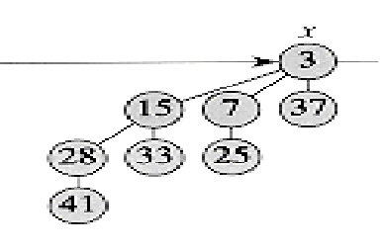
Binomial-Heap-Union
Finally, the union of H₁ and H₂ will look like this:
H
Running time for examining the sum of roots of heaps H₁ and H₂ : O(log n )

Slide 14

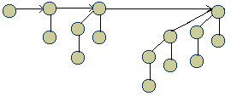
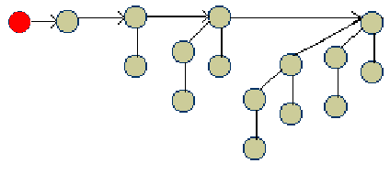
Binomial-Heap-Insert
-inserts node x into binomial heap H
Binomial-Heap-Insert(H, x)
H’ ← Make-Binomial-Heap()
p[x] ← NIL
child[x[ ← NIL
sibling[x] ← NIL
degree[x] ← 0
head[H’] ← x
H ← Binomial-Heap-Union(H, H’)
Running time:
Make-Binomial-Heap() = O(1)
Binomial-Heap-Union = O(logn)

Slide 15
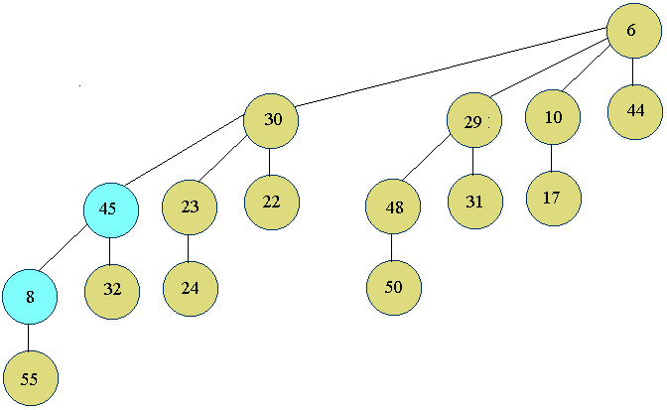
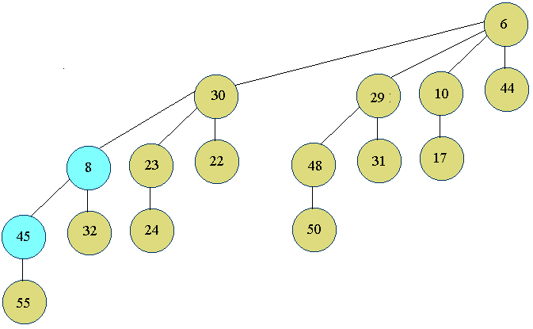
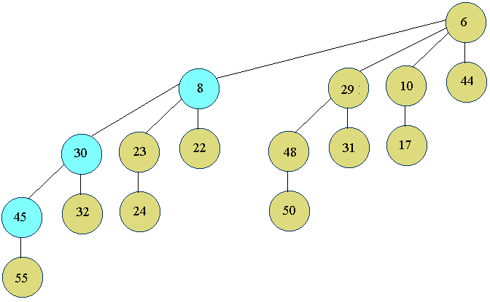
Binomial-Heap-Decrease-Key
-decreases the key of a node x in a binomial heap H to a new value k
Binomial-Heap-Decrease-Key(H, x, k)
if k > Key[x]
then error “new key is greater than current key”
key[x] ← k
y ← x
z ← p[y]
while z ≠ NIL and Key[y] key[z]
do exchange key[y] ↔ key[z]
> if y and z have satellite fields, exchange them, too
y ← z
z ← p[y]

Slide 16
Applications
Mergeable heaps are used:
In priority queues:
-scheduling user tasks on a network.
to find minimum spanning trees of undirected graphs
-highways
-computer networks
-telephone lines
-television cables

Slide 17
References
Thomas H. Cormen, Charles E. Leiserson, Ronald L, Rivest, Introduction to Algorithms, MIT Press; New York : McGraw-Hill, c1990
http://wwwcsif.cs.ucdavis.edu/~fletcher/classes/110/lecture_notes.html
http://www2.ics.hawaii.edu/~sugihara/course/ics311s00/plan.html

